Slide 1

Predicting Customer Subscription for
Term Deposits
Final Project Results and website
29-Feb-2024

Slide 2
Agenda
Introduction to Service
Why This Model?
Insight

Slide 3
introduction to Service
https://github.com/N0VA-code/Data-Glacier-Data-Based-Consulting-Project.git

Slide 4
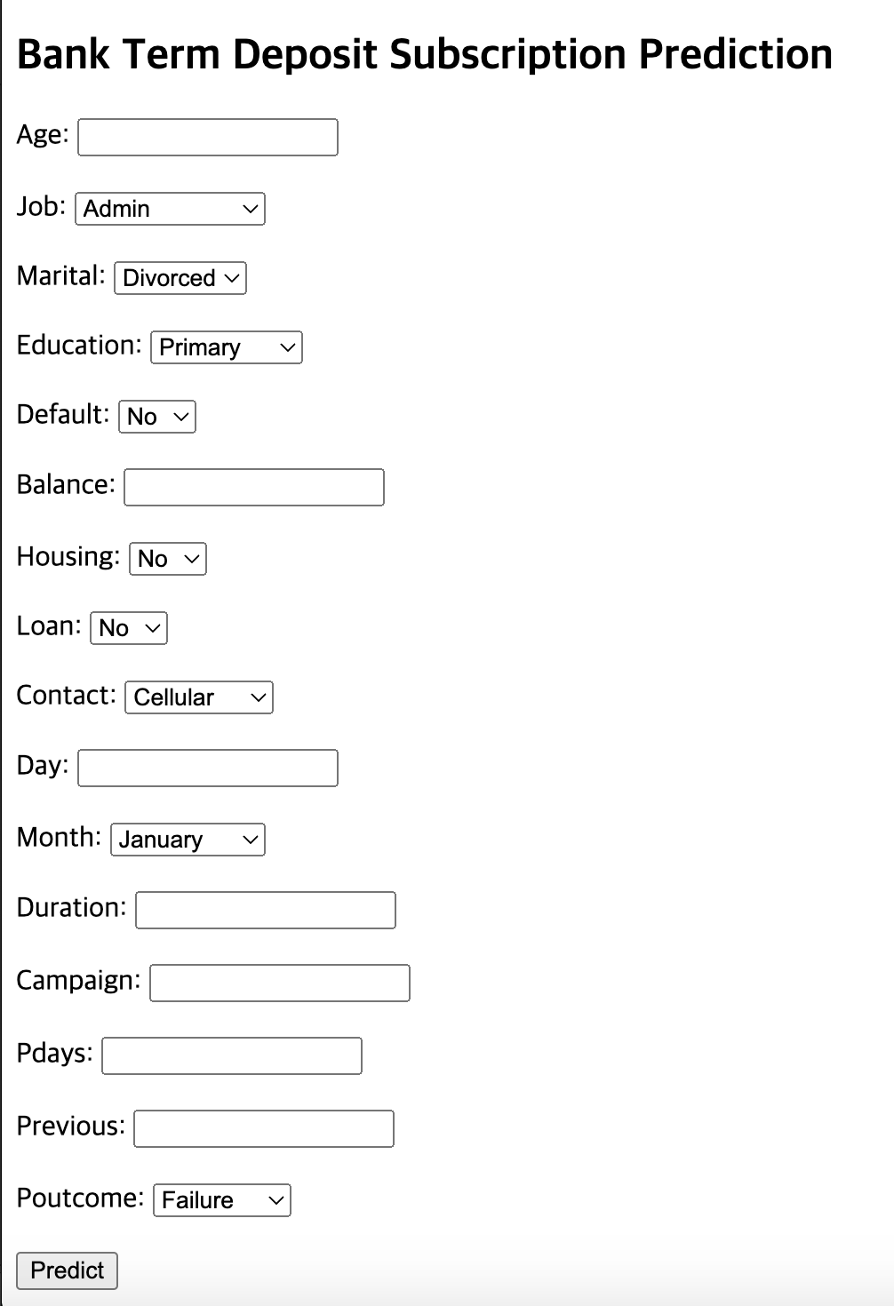
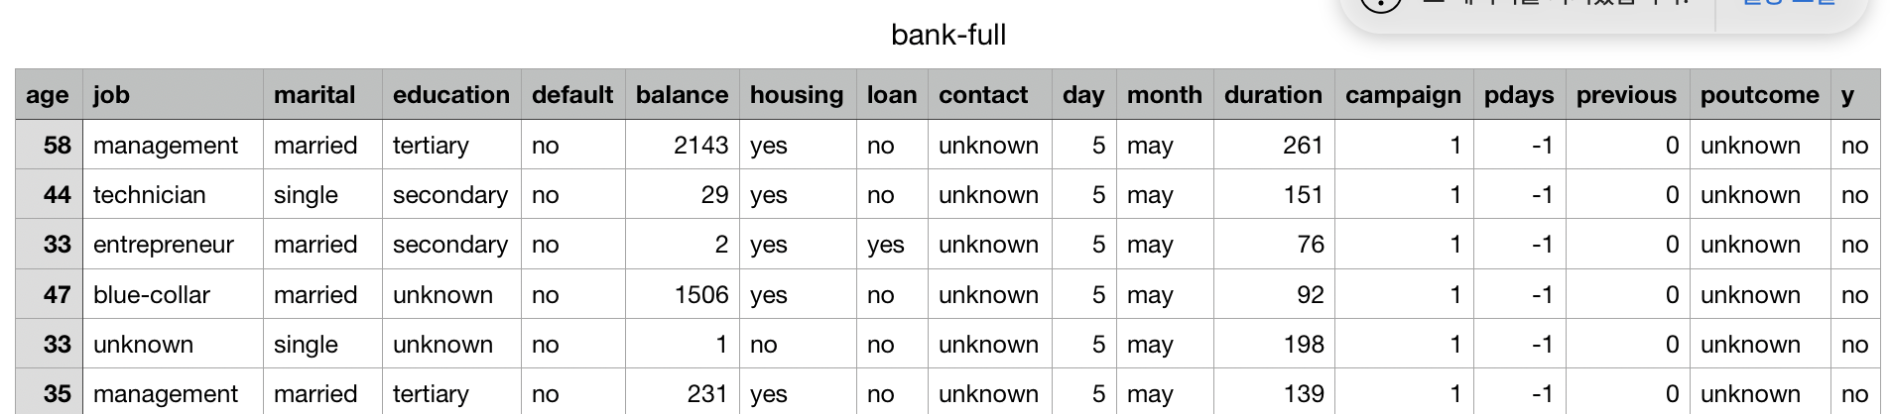
Introduction to Service
Target
Column

Slide 5
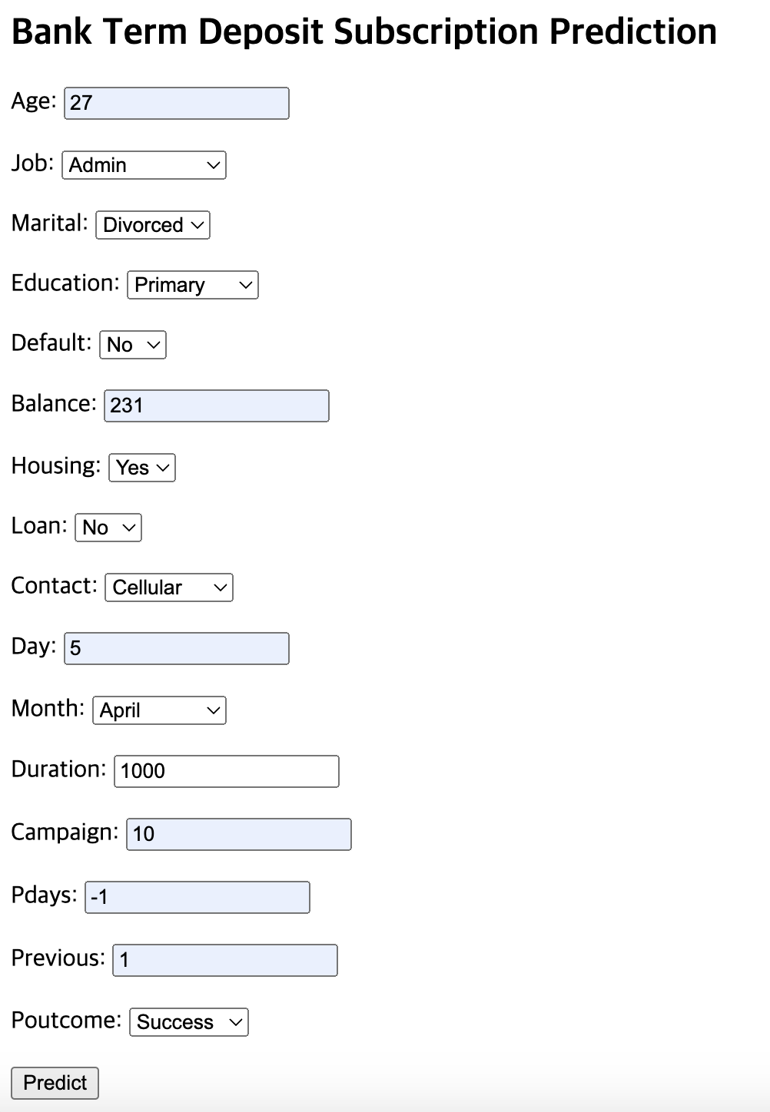
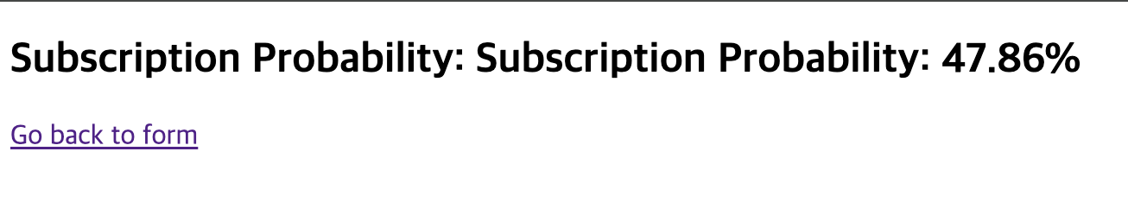
Introduction to Service - Example

Slide 6
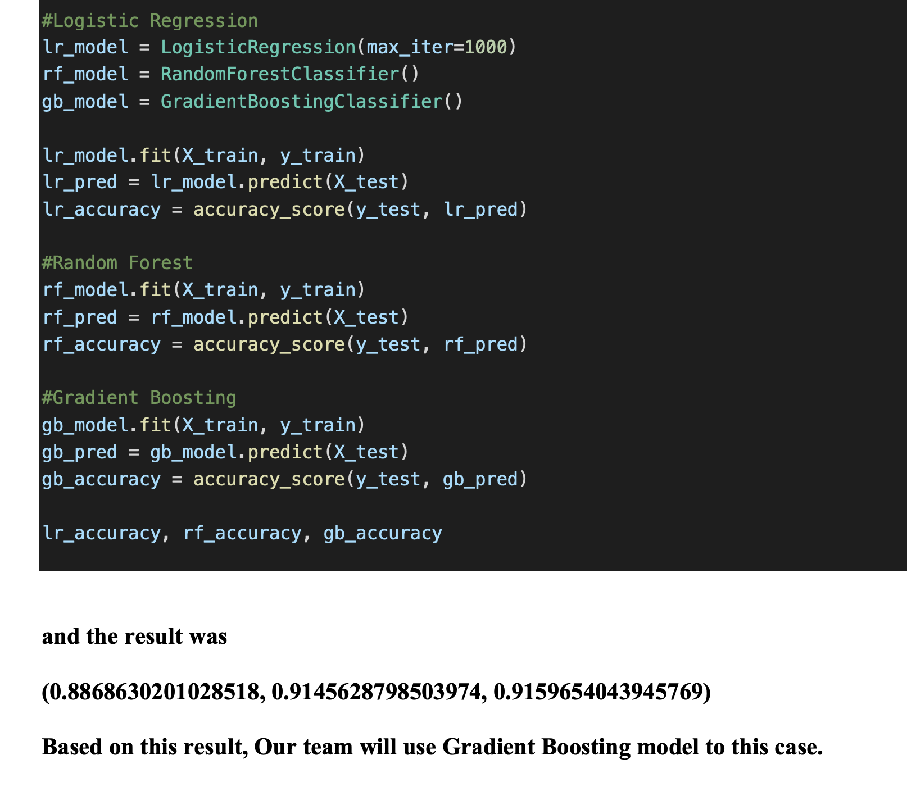
Why This Model?

Slide 7
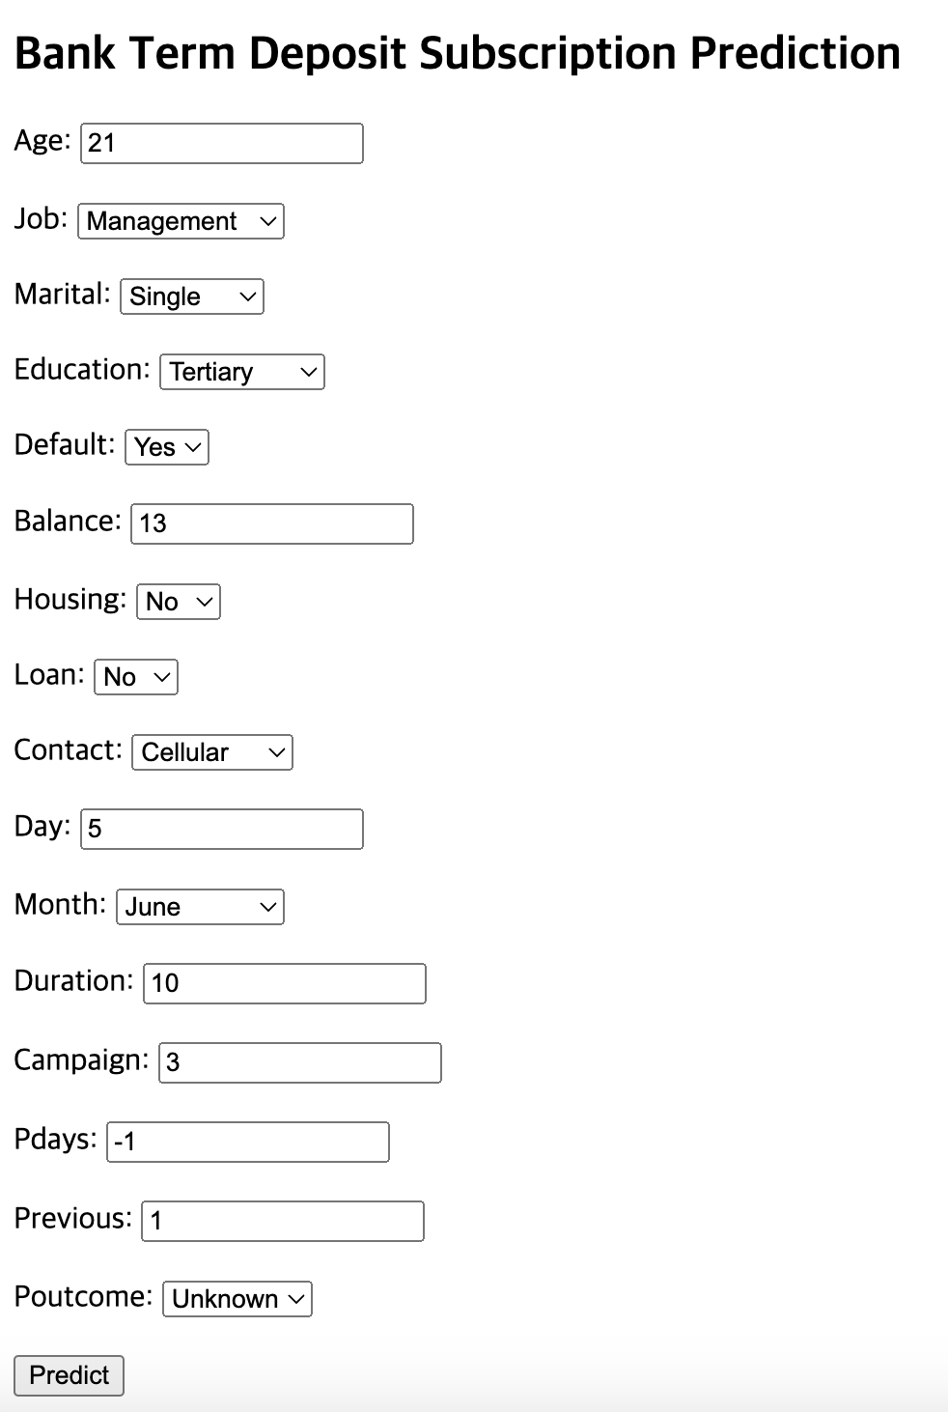
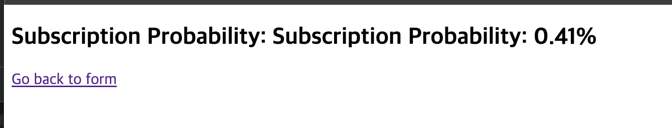
Insights

Slide 8
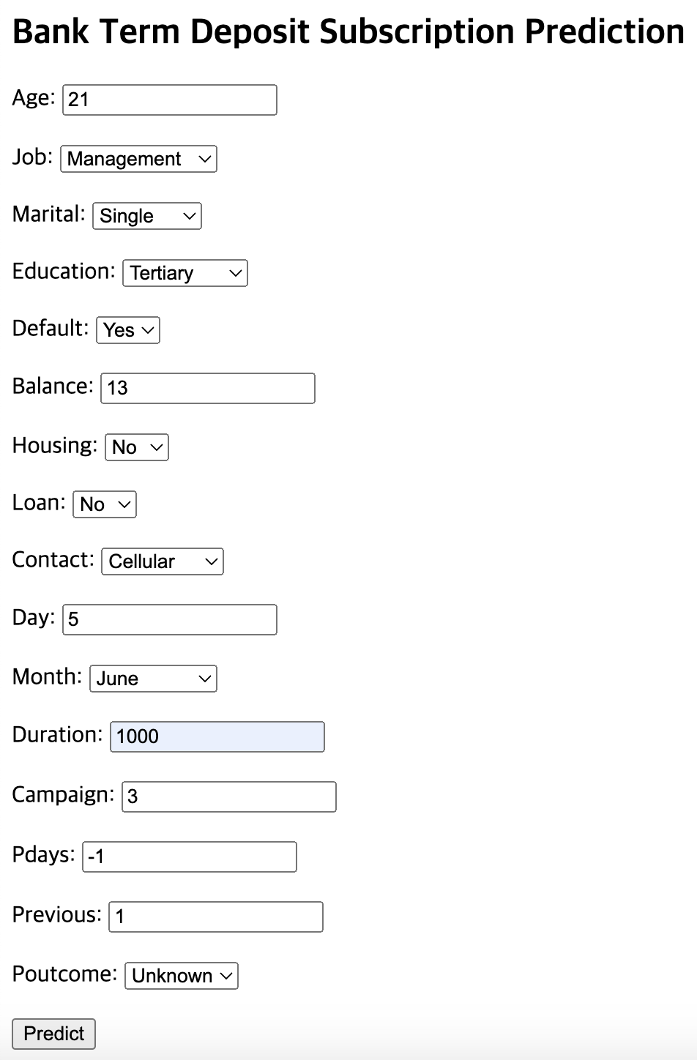
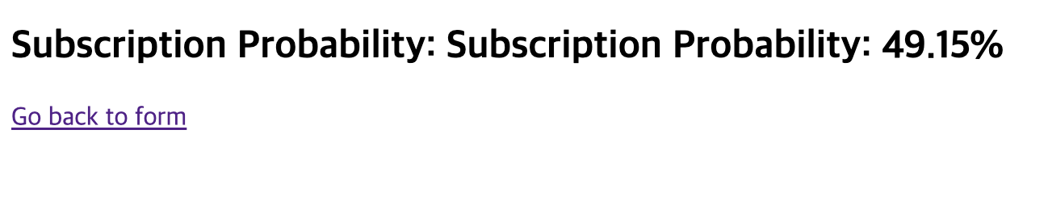
Insights

Slide 9
Insights
One interesting fact is that the most effective factor is Duration

Slide 10
Thank You

